Slide 1

Techniques being used
Predicting Price
Recommender System

Slide 2
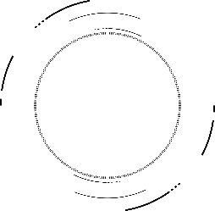

01
Why is flask?
In the follow-up research based on machine learning, the main development language is python. The unified development language of the whole system is convenient for development and later maintenance.
Flask is a lightweight web application framework written in Python.

Slide 3
02
Predicting Price
Data Analysis
Select Algorithm
First, we used the crawler to get the renting house information from Beike, about 30000 in Beijing. Then, we also do some data processing and feature encoding..
For random forest, It can reduce errors, handle large amount of data and the effect of outliers is small. And we also changed the validation set size and hyperparameters to find the higher accuracy.
Performance
Export Model
Finally, we found that random forest has the highest accuracy with 0.89, if the accepted error is 40%. The accuracy field is around 60%-140%.
PROJECT
Finally, we export the model by using pickle. It is a kind of file to store the result of model.
PLAN
2030

Slide 4
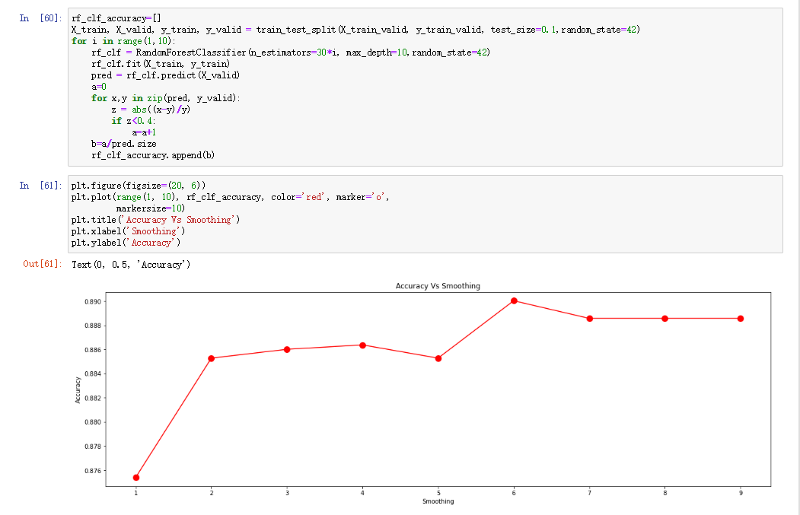
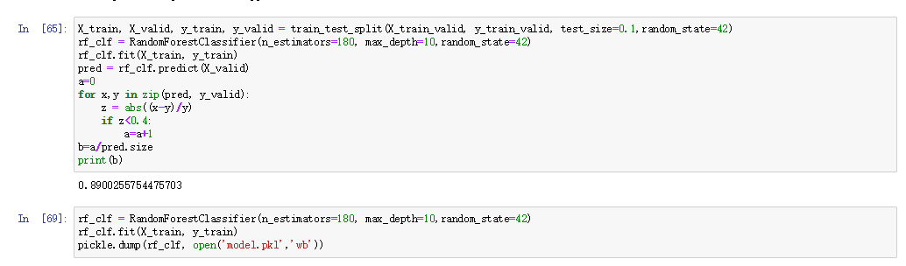
02
Predicting Price

Slide 5
03
Recommender
System
Feature Select
For recommender system, we using feature select, and recommending related houses by related feature. If the number of houses is small, related house is recommended according to some other important features.
PROJECT
PLAN
2030

